Slide 1

Lets Learn
About
Statements.
Conditional
PRESENTED BY:
AADITYA PRADHAN
NARAYAN SHRESTHA

Slide 2
What are Conditional Statements?
Conditional statements are fundamental constructs in programming that allow you to control the flow of your code based on certain conditions.
These statements evaluate whether a particular condition is true or false and then execute certain blocks of code accordingly.

Slide 3
Why are Conditional Statements important in Python?
Control Flow: They allow you to control the flow of your program based on certain conditions. This means you can dictate which parts of your code should execute under specific circumstances.
Decision Making: Conditional statements enable your program to make decisions. You can set up conditions to check whether certain criteria are met, and then execute different blocks of code accordingly. This is crucial for creating dynamic and responsive applications.
Handling Different Cases: Python programs often need to handle different cases or scenarios. Conditional statements provide a way to address each case appropriately by executing the corresponding code block.
Error Handling: They are vital for error handling and exception handling. By using conditional statements, you can anticipate potential errors or unexpected situations and handle them gracefully within your code.
User Interaction: In applications with user interaction, such as games or user interfaces, conditional statements are indispensable. They allow your program to respond to user input dynamically, providing a personalized experience.

Slide 4
Conditional Statements and Branching
If Statements
If else Statements
The if-elif-else Chain
Multiple elif Usage
Switch Case

Slide 5
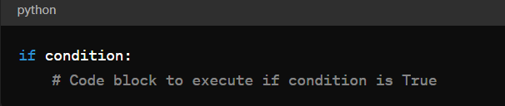
OVERVIEW OF IF, ELIF AND ELSE STATEMENTS IN PYTHON:
The if, elif and else statements are fundamental constructs in Python for implementing conditional logic. They allow you to control the flow of your program based on specific conditions.
What are if Statements ??
The if statement is used to execute a block of code only if a specified condition evaluates to True. If the condition is False, the code block associated with the if statement is skipped entirely.

Slide 6
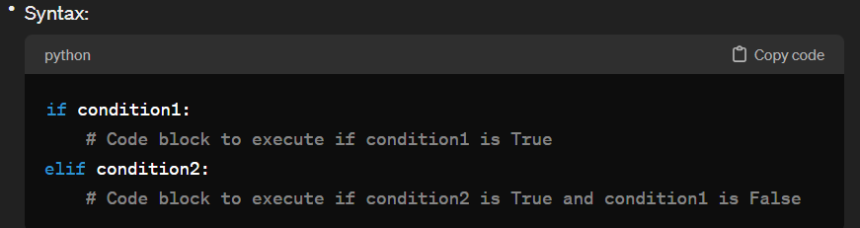
2. What are elif Statement ??
The elif statement allows you to check additional conditions if the preceding if statement's condition is False. It stands for "else if." You can have multiple elif statements to check for multiple conditions sequentially.

Slide 7
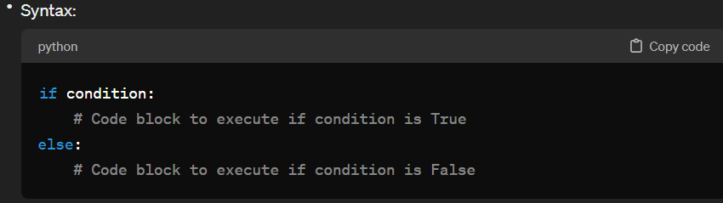
3. What are Else Statement ??
The else statement is used to execute a block of code if none of the preceding conditions in the if or elif statements are True.
It provides a fallback option when all other conditions fail.

Slide 8
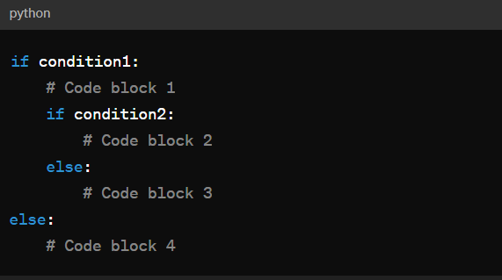
4. What are Nested if Statements ??
Nested if statements are if statements placed inside other if statements.
Nested if statements allow for more complex decision-making within a program.

Slide 9
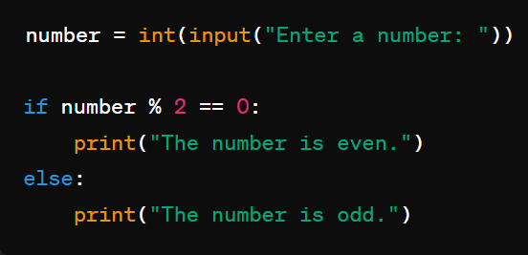
Lets See Some Examples that may helps us to be More Familier with it.
Example 01:

Slide 10
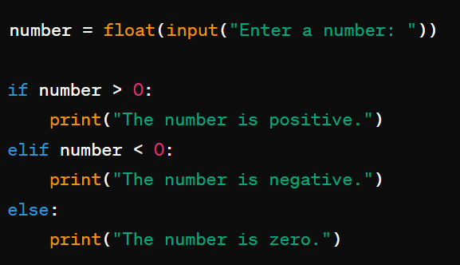
The if-elif-else Chain
Example:02

Slide 11
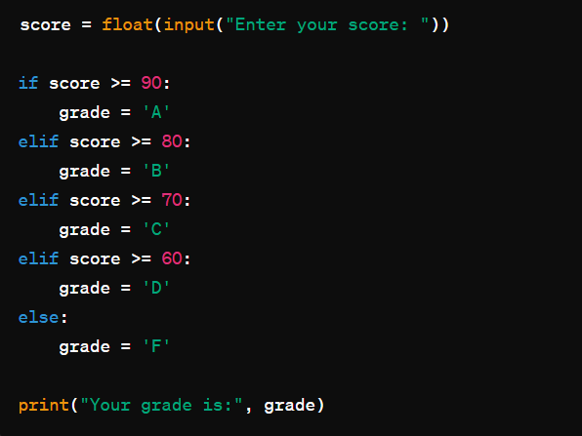
Example:03

Slide 12
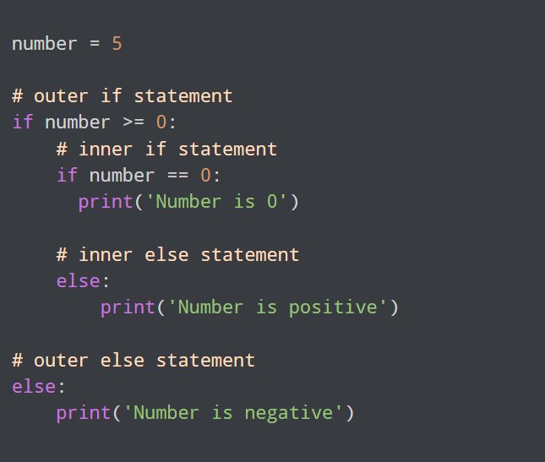
Example:04

Slide 13
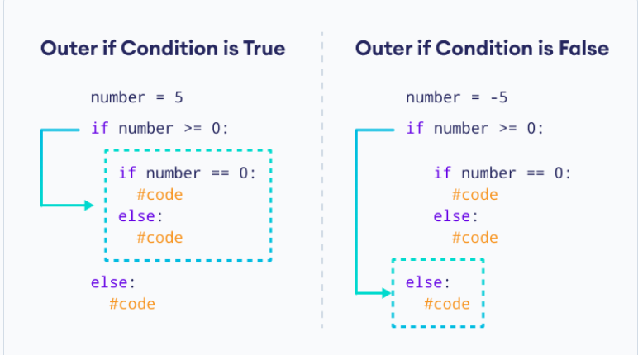
HOW CODE EXECUTES:

Slide 14
SWITCH CASE:
In many programming languages like C, C++, and Java, there's a control flow statement called switch-case, which allows you to select one of many blocks of code to execute based on the value of a given expression or variable. However, Python does not have a built-in switch-case statement.
Instead, in Python, you typically use if, elif, and else statements to achieve similar functionality. These statements allow you to check conditions and execute different blocks of code accordingly, making them more versatile than the switch-case statement found in other languages.

Slide 15
ANY QUERIES??

Slide 16
THANKS
YOU
FOR YOUR
TIME 😁

